Slide 1
Dart Throwing Monkeys and Buffett’s Bold Bet: Most Professional Investors Can’t Beat the Market
In his classic investing book A Random Walk Down Wall Street, Princeton University professor Burton Malkiel famously stated,
“A blindfolded monkey throwing darts at a newspaper’s financial pages could select a portfolio that would do just as well as one carefully selected by experts.” The “experts”, understandably, were not amused. However, in numerous experiments over the years the monkeys have held their own.
Yet how is the market thought off when it comes to deeming its expected instruments future values ?
That´s a bit of a big question for the actual scope of this very project, however to place into perspective the actual approach to illustrate in my book two basic approaches, I would like to address the following:
Market Indicator analysis for Price vs. Volume dynamics, this referred to the sp500, and a usual analysis criteria used by traders , known as Dual moving average crossover to determine when to Buy and when to Sell Stock, it occurs when a short term average crosses a long term average , the signal indicator is used to identify the momentum is shifting in the direction of the short term average, and a buy signals generated when the short term average crosses the long term average, and rises above it, while a sale signal is triggered by a short term average crossing the long term average falling below it.

Slide 2
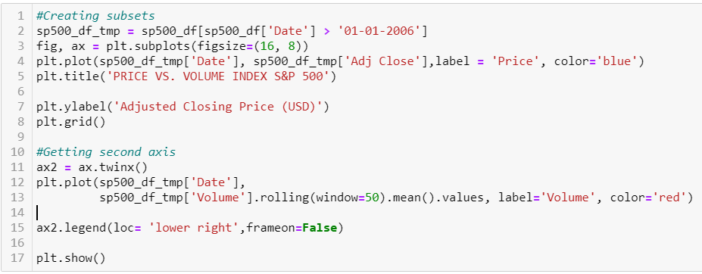
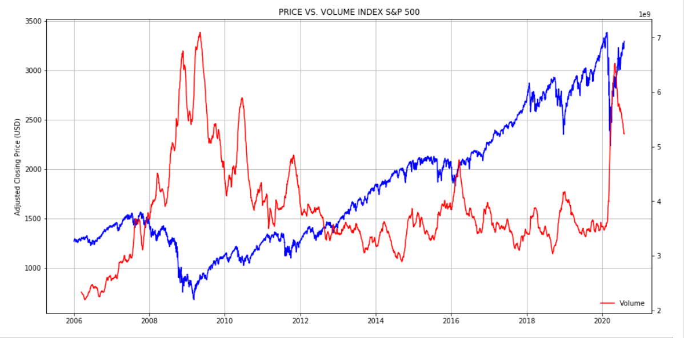
Price vs. Volume SP500 INDEX

Slide 3
Price vs. Volume SP500 INDEX

Slide 4
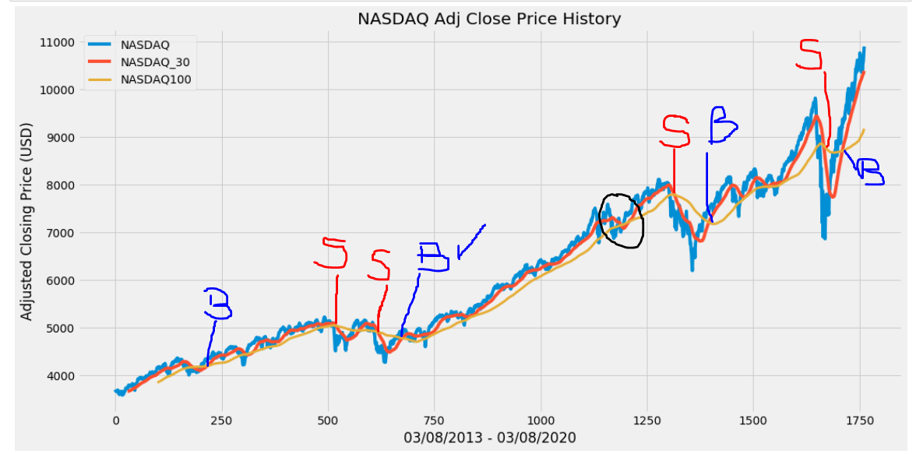
Dual moving average crossover to determine when to Buy and when to Sell Stock
It occurs when a short term average crosses a long term average , the signal indicator is used to identify the momentum is shifting in the direction of the short term average, and a buy signals generated when the short term average crosses the long term average, and rises above it, while a sale signal is triggered by a short term average crossing the long term average falling below it.

Slide 5
Dual moving average crossover to determine when to Buy and when to Sell Stock

